Slide 1
Chapter 10
Income and Spending

Slide 2
Review from the previous session
Incorporate the other components of AD: G, I, taxes, transfer payments, and foreign trade
AD then becomes:
where A is independent of the level of income, or autonomous

Slide 3
Review from the previous session
Saving and Investment
No government and foreign trade:
I = S
With government and foreign trade:
I = S + (TA – TR – G) - NX

Slide 4
What do we learn today?
What is a multiplier?
Does the multiplier differ in case of using different types of fiscal policies?
How a change in government purchases affects the budget balance?
(BS = TA – TR – G)

Slide 5
The Multiplier
By how much does a $1 increase in autonomous spending raise the equilibrium level of income? → The answer is not $1
Out of an additional dollar in income, $c is consumed
Output increases to meet increased expenditure; change in output = (1+c)
Expansion in output and income results in further increases

Slide 6
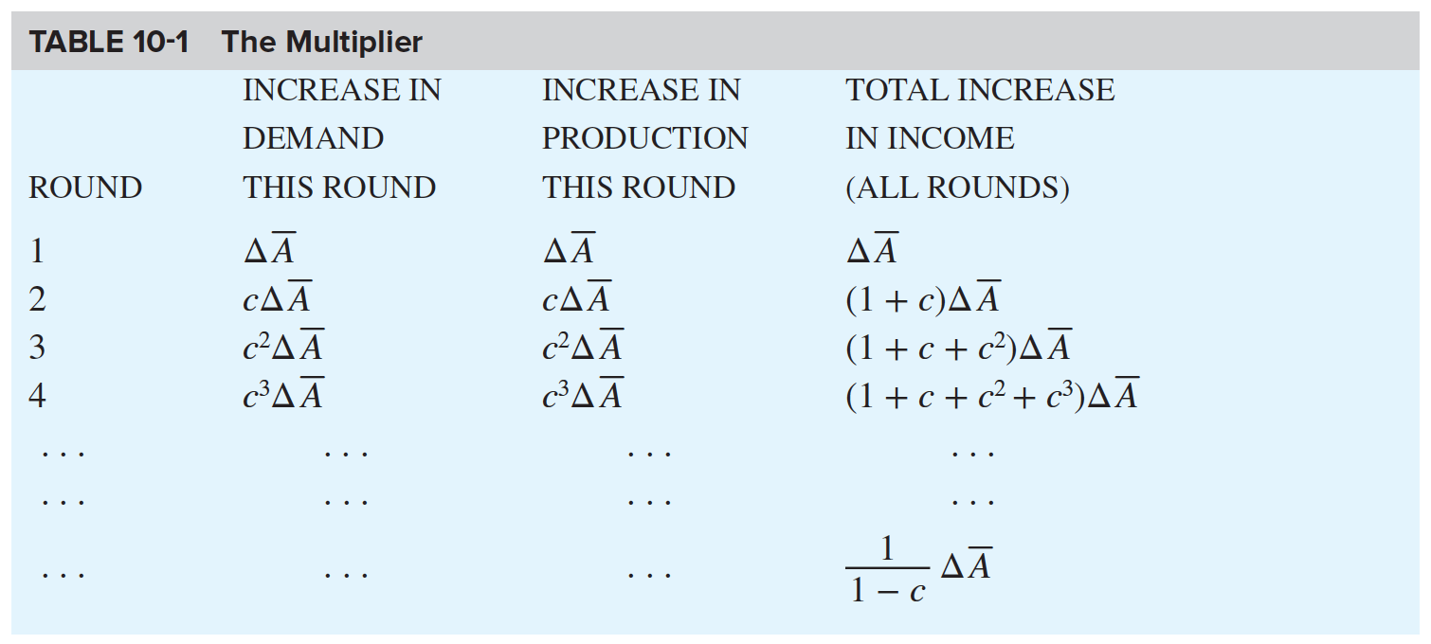
The Multiplier

Slide 7
The Multiplier
The general definition of the multiplier is
Multiplier = amount by which equilibrium output changes when autonomous aggregate demand increases by 1 unit

Slide 8
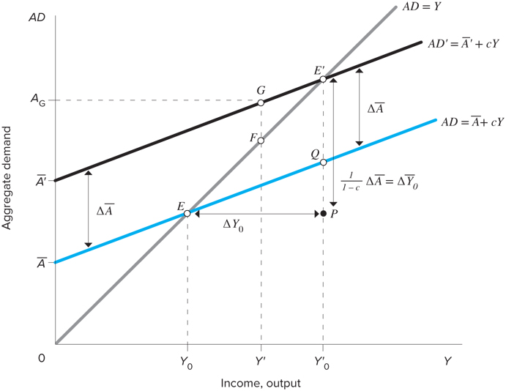
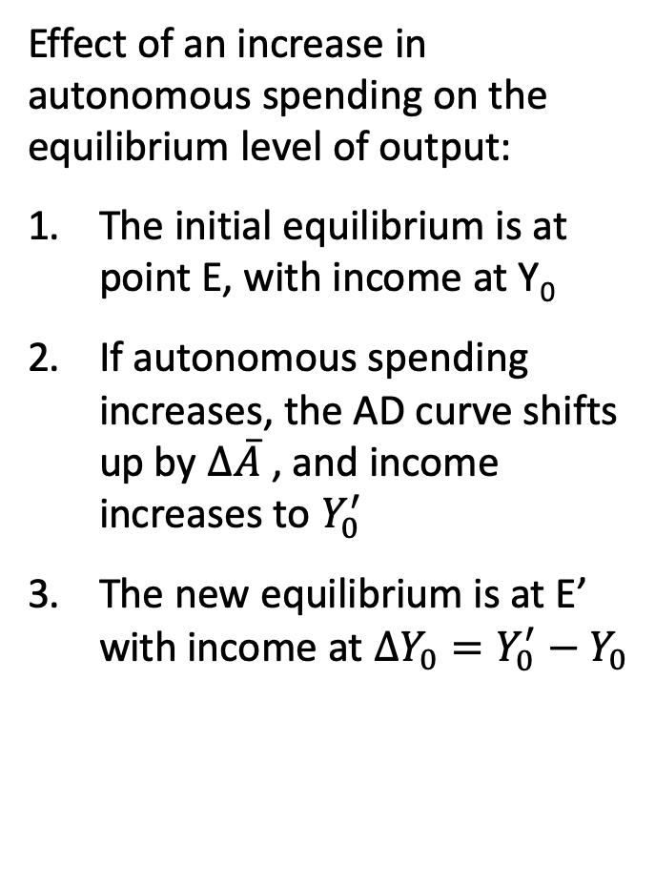

The Multiplier
Effect of an increase in autonomous spending on the equilibrium level of output:
The initial equilibrium is at point E, with income at Y₀
If autonomous spending increases, the AD curve shifts up by $∆\overline{A}$ , and income increases to $Y_{0}^{′}$
The new equilibrium is at E’ with income at $∆Y_{0}=Y_{0}^{′}−Y_{0}$

Slide 9
The Government Sector
The government affects the level of equilibrium output in two ways:
Government expenditures (component of AD)
Taxes and transfers
Fiscal policy is the policy of the government with regards to G, TR, and TA
Assume G and TR are constant, and that there is a proportional income tax at rate t
The consumption function becomes:

Slide 10
The Government Sector
Combining with AD:
Using the equilibrium condition, Y=AD, the equilibrium level of output is:
The presence of the government sector flattens the AD curve and reduces the multiplier to

Slide 11
Income Taxes as an Automatic Stabilizer
Automatic stabilizer is any mechanism in the economy that automatically (without case-by-case government intervention) reduces the amount by which output changes in response to a change in autonomous spending
One explanation of the business cycle is that it is caused by shifts in autonomous spending, especially investment
Swings in investment spending have a smaller effect on output when automatic stabilizers are in place

Slide 12
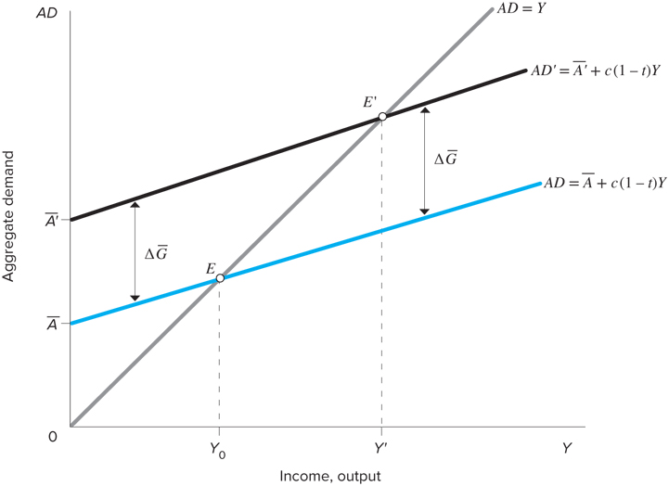
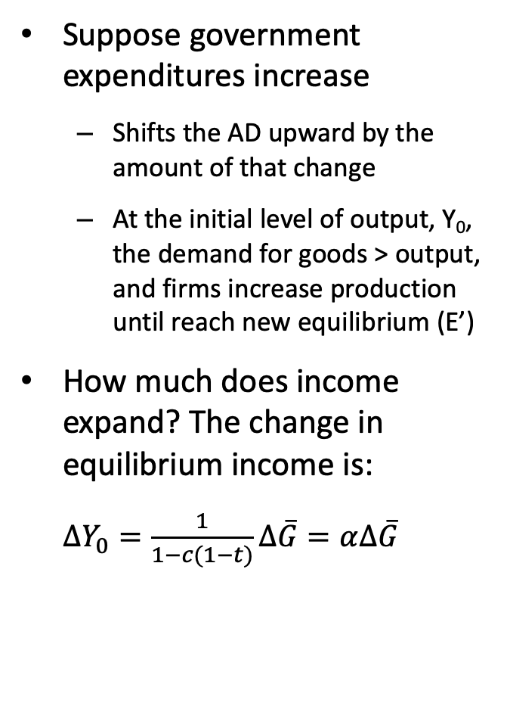
Effects of a Change in Fiscal Policy
Suppose government expenditures increase
Shifts the AD upward by the amount of that change
At the initial level of output, Y₀, the demand for goods > output, and firms increase production until reach new equilibrium (E’)
How much does income expand? The change in equilibrium income is:
$∆Y_{0}=\frac{1}{1−c(1−t)}∆\overline{G}=α∆\overline{G}$

Slide 13
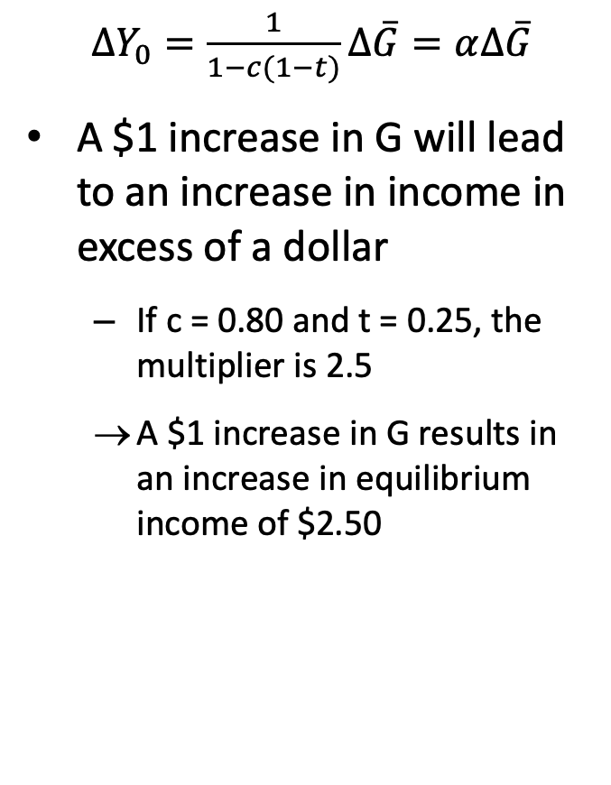
Effects of a Change in Fiscal Policy
$∆Y_{0}=\frac{1}{1−c(1−t)}∆\overline{G}=α∆\overline{G}$
A $1 increase in G will lead to an increase in income in excess of a dollar
If c = 0.80 and t = 0.25, the multiplier is 2.5
A $1 increase in G results in an increase in equilibrium income of $2.50

Slide 14
Effects of a Change in Fiscal Policy
Suppose government increases TR instead
Autonomous spending would increase by only cΔTR, so output would increase by α_{G} cΔTR
The multiplier for transfer payments is smaller than that for G by a factor of c

Slide 15
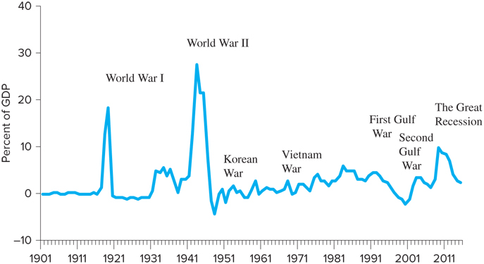
The Government Budget
Government budget deficits have been the norm in the U.S. since the 1960s
Is there a reason for concern over a budget deficit?

Slide 16
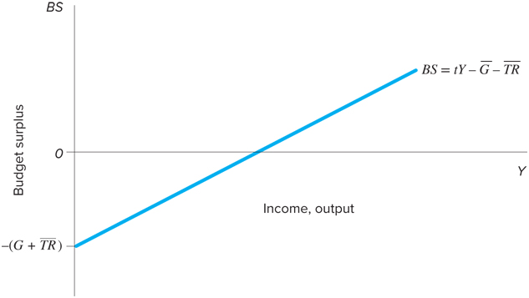
The Government Budget
If TA = tY, the budget surplus is defined as:
Figure below shows that the budget surplus depends on the government’s policy choices (G, t, and TR) and also anything else that shifts the level of income

Slide 17
Effects of Government Purchases and Tax Changes on the BS
How do changes in fiscal policy affect the budget? OR Must an increase in G reduce the BS?
An increase in G reduces the surplus, but also increases income, and thus tax revenues
Possibility that increased tax collections > increase in G

Slide 18
Effects of Government Purchases and Tax Changes on the BS
The change in income due to increased G is equal to
, a fraction of which is collected in taxes
Tax revenues increases by
The change in BS is

